Slide 1
TCP / IP Protocol Suite
Prof. Dr. Md Zahidul Islam

Slide 2
1.2
PROTOCOLS
AND
STANDARDS

Slide 3
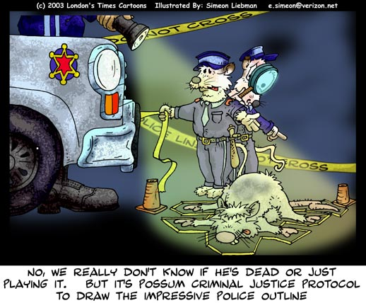

Protocols
Syntax
Semantics
Timing

Slide 4

Standards
De facto: e.g., TCP/IP
De jure: e.g., ISO OSI

Slide 5
1.3
STANDARDS
ORGANIZATIONS

Slide 6
Standards Creation Committees
International Standards Organization (ISO)
International Telecommunications Union–
Telecommunication Standards Sector (ITU-T)
American National Standards Institute (ANSI)
Institute of Electrical and Electronics Engineers (IEEE)
Electronic Industries Association (EIA)

Slide 7
Forums
Frame Relay Forum
ATM Forum
Regulatory Agencies
Federal Communications Commission (FCC)
National Communications Commission (NCC)

Slide 8

The websites for the above organizations are given in Appendix G.

Slide 9
1.4
INTERNET
STANDARDS

Slide 10
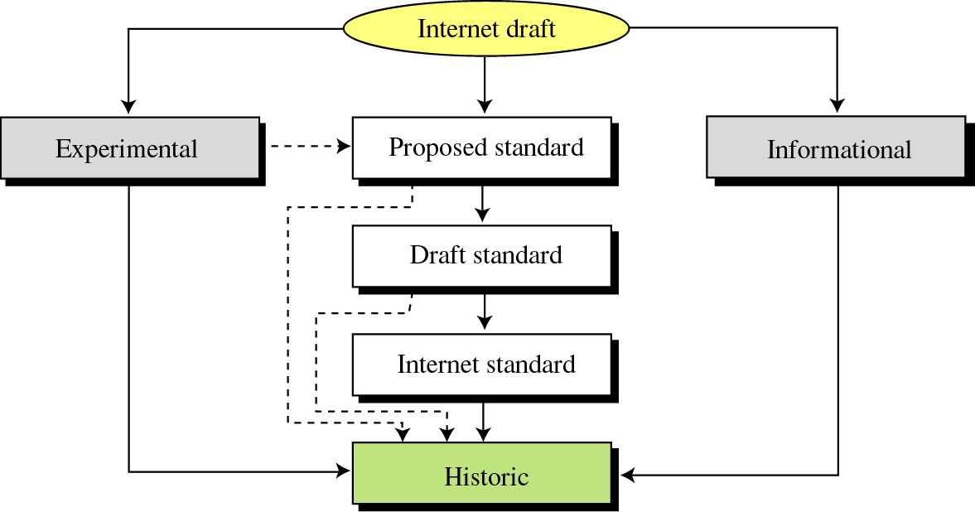
Figure 1-2
Maturity levels of an RFC

Slide 11
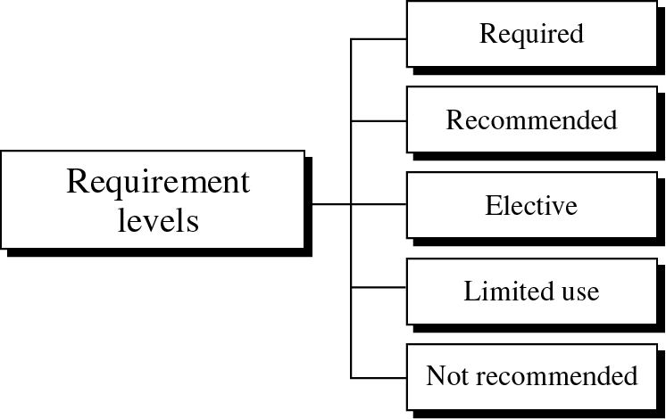
Figure 1-3
Requirement levels of an RFC

Slide 12
1.5
INTERNET
ADMINISTRATION

Slide 13
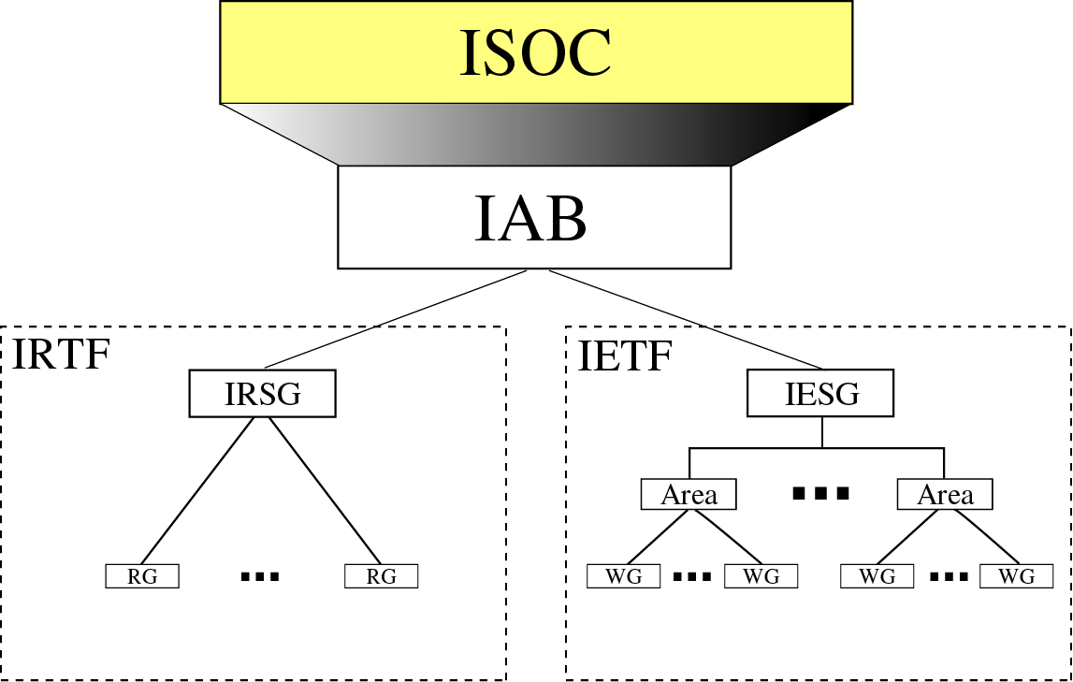
Figure 1-4
Internet Administration
Internet Architecture Board
Internet Research Task Force
Internet Engineering Task Force
SG: Steering
Group

Slide 14
Internet Numbers
IP addresses
Protocol numbers
Domain names
…
IANA (Internet Assigned Numbers Authority)
ICANN (Internet Corporation for Assigned Names and Numbers)

Slide 15
Chapter 2
The OSI Model and
TCP/IP
Protocol Suite

Slide 16
CONTENTS
THE OSI MODEL
LAYERS IN THE OSI MODEL
TCP/IP PROTOCOL SUITE
ADDRESSING
TCP/IP VERSIONS

Slide 17
2.1
THE
OSI
MODEL

Slide 18
ISO is the organization. OSI is the model.

Slide 19
Headers are added to the data at layers 6, 5, 4, 3, and 2. Trailers are usually added only at layer 2.

Slide 20
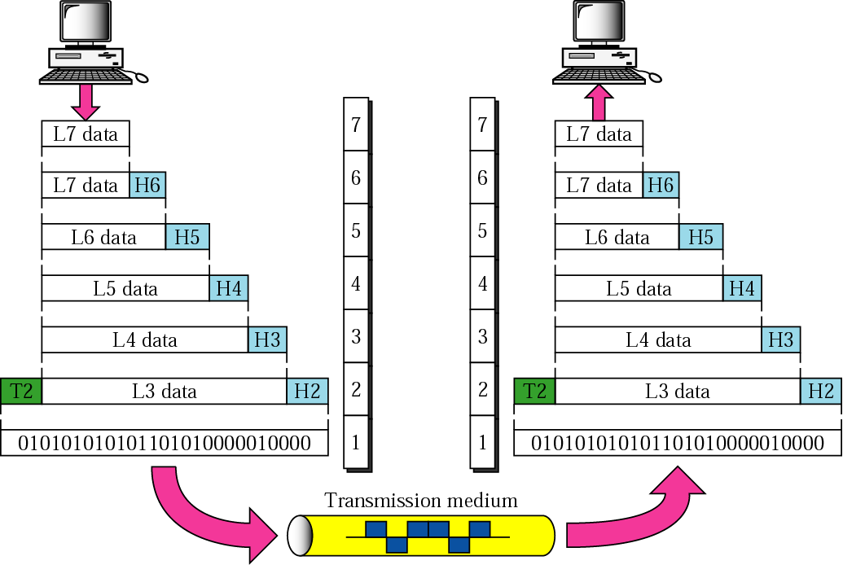
Figure 2-3
An exchange using the OSI model

Slide 21
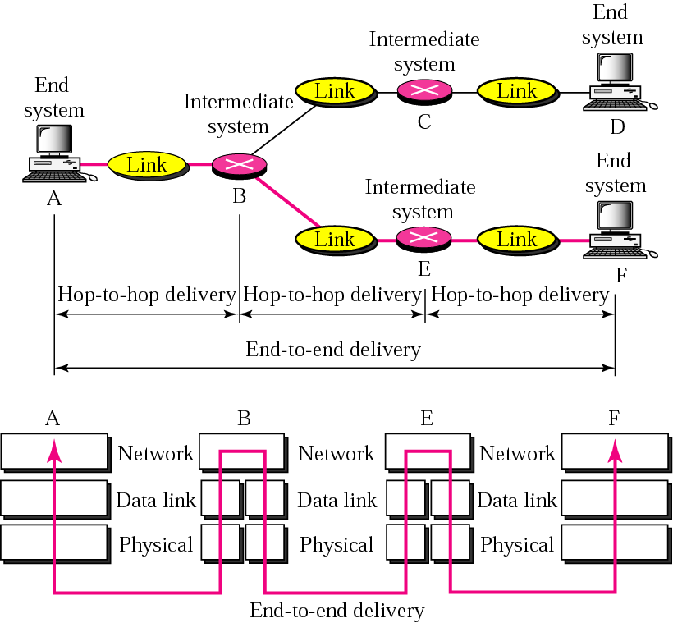
Figure 2-8
End-to-end delivery

Slide 22
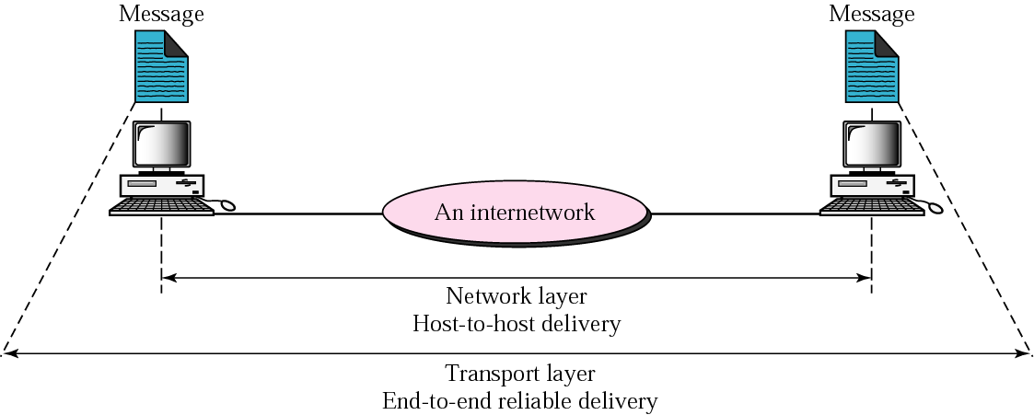
Figure 2-10
Reliable end-to-end delivery of a message

Slide 23
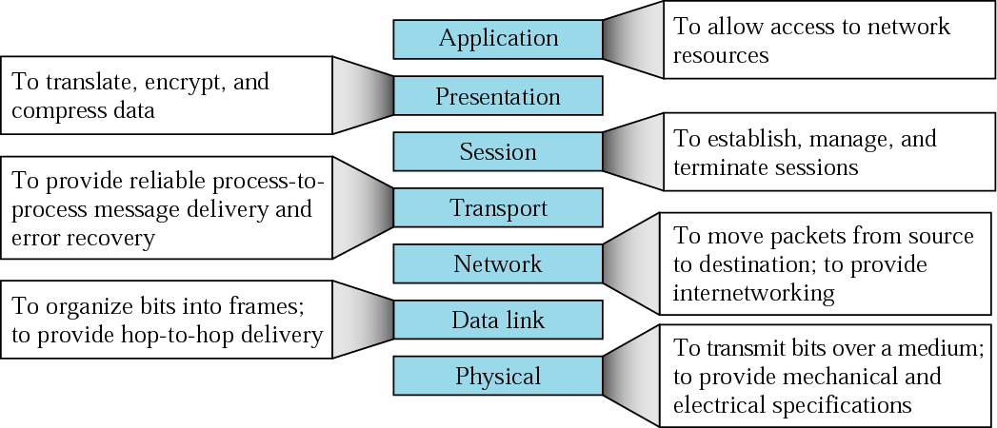
Figure 2-14
Summary of layers

Slide 24
2.3
TCP/IP
PROTOCOL
SUITE

Slide 25
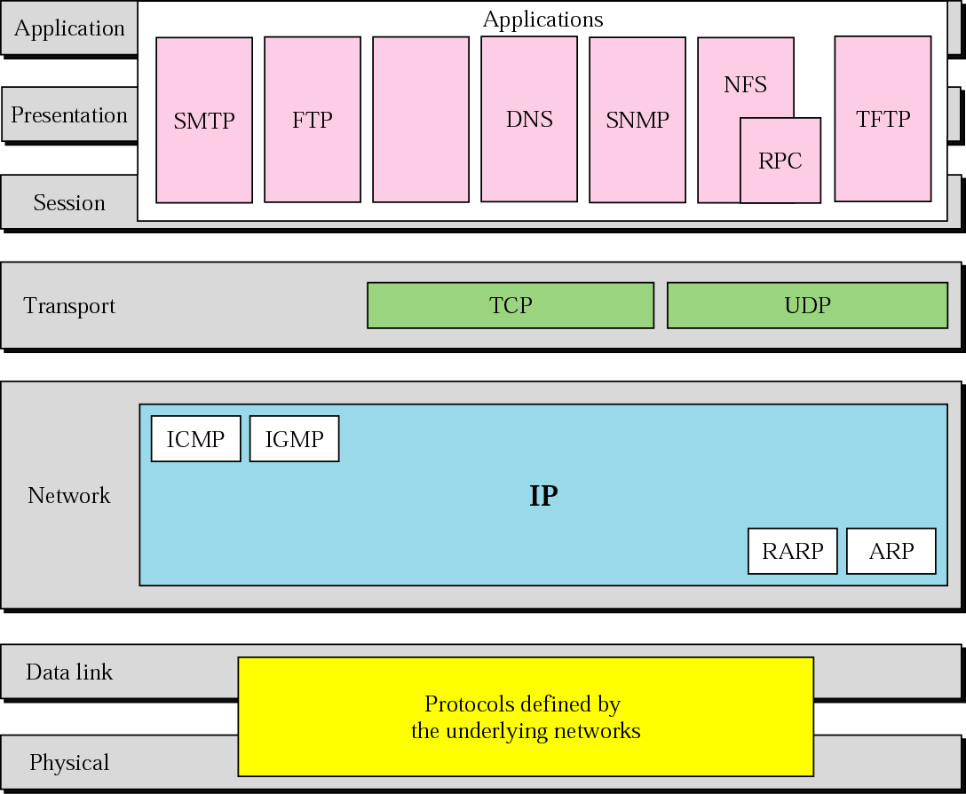
Figure 2-15
TCP/IP and OSI model

Slide 26
2.4
ADDRESSING

Slide 27
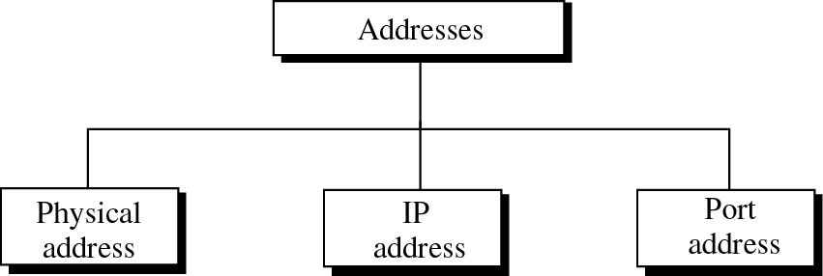
Figure 2-16
Addresses in TCP/IP

Slide 28
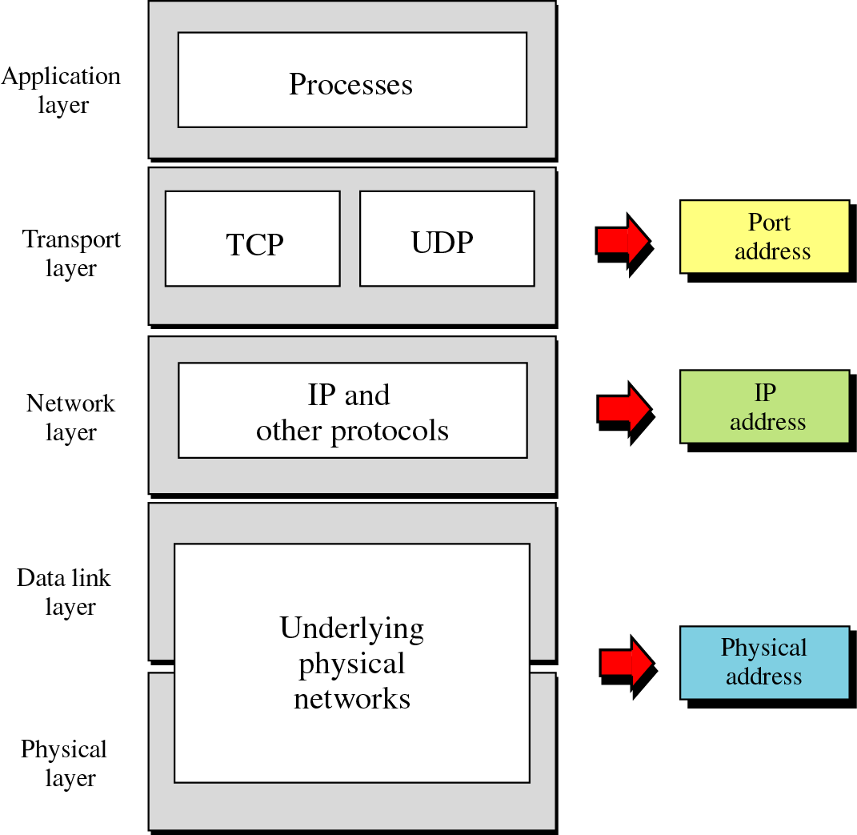
Figure 2-17
Relation-
ship
of
layers
and
addresses
in TCP/IP

Slide 29
Example 1
Figure 2.18 shows an example of physical addresses.

Slide 30
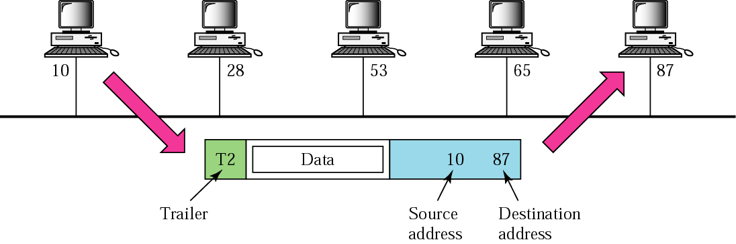
Figure 2-18
Physical addresses

Slide 31
Example 2
Most local area networks use a 48-bit (6 bytes) physical address written as 12 hexadecimal digits, with every 2 bytes separated by a hyphen as shown below:
07-01-02-01-2C-4B
A 6-byte (12 hexadecimal digits) physical address

Slide 32
Example 3
Figure 2.19 shows an example of Internet addresses.

Slide 33
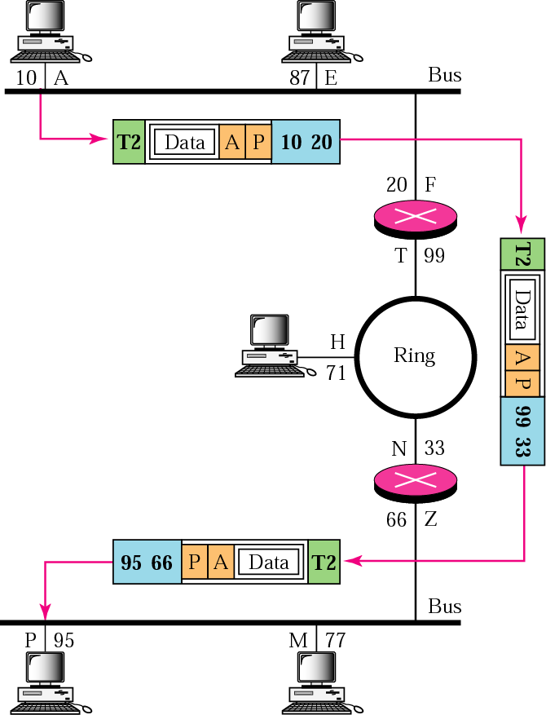
Figure 2-19
IP addresses
Note the changes in physical address!!

Slide 34
Example 4
As we will see in Chapter 4, an Internet address (in IPv4) is 32 bits in length, normally written as four decimal numbers, with each number representing 1 byte. The numbers are separated by a dot. Below is an example of such an address.
132.24.75.9

Slide 35
Example 5
Figure 2.20 shows an example of transport layer communication.

Slide 36
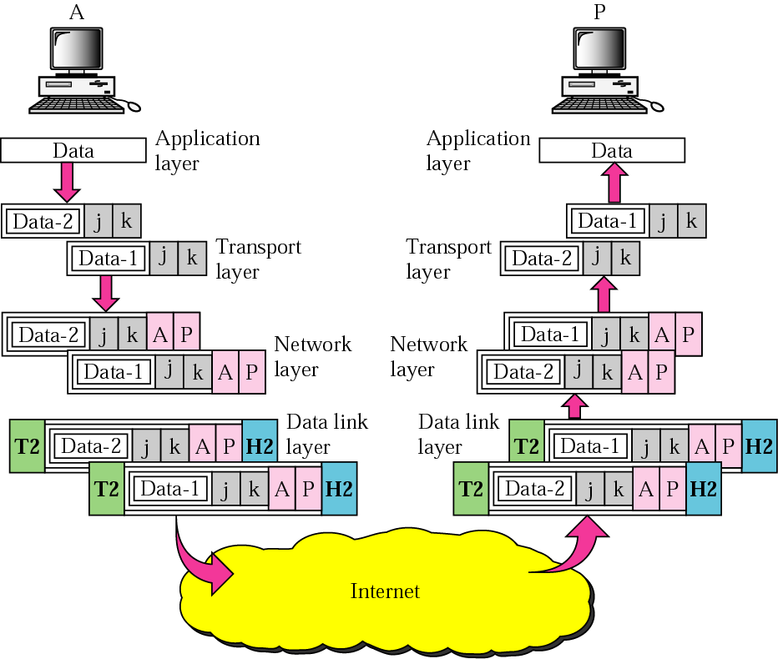
Figure 2-20
Port addresses

Slide 37
Example 6
As we will see in Chapters 11 and 12, a port address is a 16-bit address represented by one decimal number as shown below.
753 A 16-bit port address

Slide 38
2.5
TCP/IP
VERSIONS

Slide 39
Versions:
Version 4 (current): 32-bit IP address
Version 5
Version 6 (in promotion): 128-bit IP address

Slide 40
Chapter 4
IP Addresses:
Classful Addressing

Slide 41
CONTENTS
INTRODUCTION
CLASSFUL ADDRESSING
OTHER ISSUES
A SAMPLE INTERNET

Slide 42
4.1
INTRODUCTION

Slide 43
An IP address is a 32-bit address.

Slide 44
The IP addresses are unique.
One IP address points to one computer.
But a computer may have many IP addresses.

Slide 45
Address Space
…………..
…………..
addr1
addr15
addr2
…………..
…………..
…………..
addr41
addr226
addr31
…………..
…………..

Slide 46
RULE:
…………..
…………..
If a protocol uses N bits to
define an address,
the address space is 2^{N}
because each bit can have two
different values (0 and 1)
and N bits can have 2^{N} values.
addr1
addr15
addr2
…………..
…………..
…………..
addr41
addr226
addr31
…………..
…………..

Slide 47
The address space of IPv4 is
2³² or 4,294,967,296.

Slide 48
Binary Notation
01110101 10010101 00011101 11101010

Slide 49
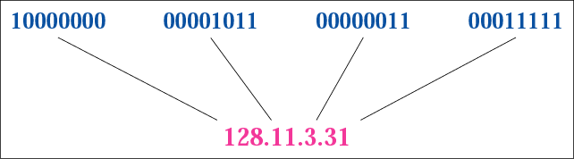
Figure 4-1
Dotted-decimal notation

Slide 50
Hexadecimal Notation
0111 0101 1001 0101 0001 1101 1110 1010
75 95 1D EA
0x75951DEA

Slide 51
The binary, decimal, and hexadecimal number systems are reviewed in Appendix B.

Slide 52
Example 1
Change the following IP address from binary notation to dotted-decimal notation.
10000001 00001011 00001011 11101111
Solution
129.11.11.239

Slide 53
Example 2
Change the following IP address from dotted-decimal notation to binary notation.
111.56.45.78
Solution
01101111 00111000 00101101 01001110

Slide 54
Example 3
Find the error, if any, in the following IP address:
111.56.045.78
Solution
There are no leading zeroes in
dotted-decimal notation (045).

Slide 55
Example 3 (continued)
Find the error, if any, in the following IP address:
75.45.301.14
Solution
In dotted-decimal notation,
each number is less than or
equal to 255; 301 is outside this range.

Slide 56
Example 4
Change the following IP addresses from binary notation to hexadecimal notation.
10000001 00001011 00001011 11101111
Solution
0X810B0BEF or 810B0BEF₁₆

Slide 57
4.2
CLASSFUL
ADDRESSING

Slide 58
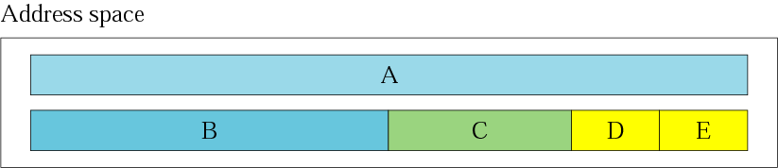
Figure 4-2
Occupation of the address space
2³¹(50%)
2³⁰(25%)
2²⁹(12.5%)
2²⁸(6.25%)

Slide 59
In classful addressing, the address space is divided into five classes: A, B, C, D, and E.

Slide 60
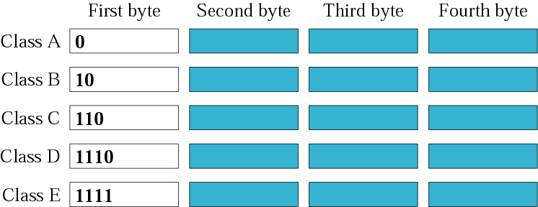
Figure 4-3
Finding the class in binary notation

Slide 61
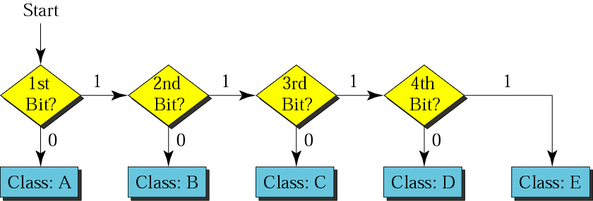
Figure 4-4
Finding the address class

Slide 62
Example 5
How can we prove that we have 2,147,483,648 addresses in class A?
Solution
In class A, only 1 bit defines the class.
The remaining 31 bits are available
for the address. With 31 bits,
we can have 2³¹ or 2,147,483,648 addresses.

Slide 63
Example 6
Find the class of the address:
00000001 00001011 00001011 11101111
Solution
The first bit is 0. This is a class A address.

Slide 64
Example 6 (Continued)
Find the class of the address:
11000001 10000011 00011011 11111111
Solution
The first 2 bits are 1; the third bit is 0.
This is a class C address.

Slide 65
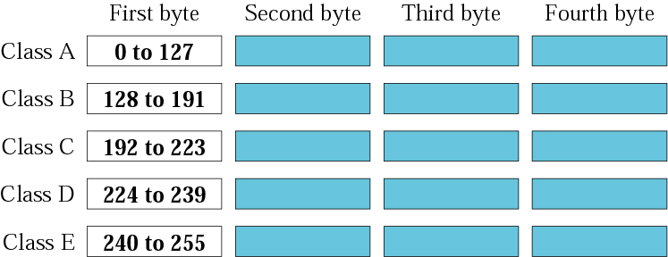
Figure 4-5
Finding the class in decimal notation

Slide 66
Example 7
Find the class of the address:
227.12.14.87
Solution
The first byte is 227 (between 224 and 239);
the class is D.

Slide 67
Example 7 (Continued)
Find the class of the address:
193.14.56.22
Solution
The first byte is 193 (between 192 and 223);
the class is C.

Slide 68
Example 8
In Example 4 we showed that class A has 2³¹ (2,147,483,648) addresses. How can we prove this same fact using dotted-decimal notation?
Solution
The addresses in class A range from 0.0.0.0 to
127.255.255.255. We notice that we are
dealing with base 256 numbers here.

Slide 69
Solution (Continued)
Each byte in the notation has a weight.
The weights are as follows:
256³ , 256², 256¹, 256⁰
Last address: 127 × 256³ + 255 × 256² + 255 × 256¹ + 255 × 256⁰ = 2,147,483,647
First address: = 0
If we subtract the first from the
last and add 1, we get 2,147,483,648.

Slide 70
Network identity (network ID) is a portion of the TCP/IP address that is used to identify individuals or devices on a network such as a local area network or the Internet. ... A network ID is also known as network identification or NetID.

Slide 71
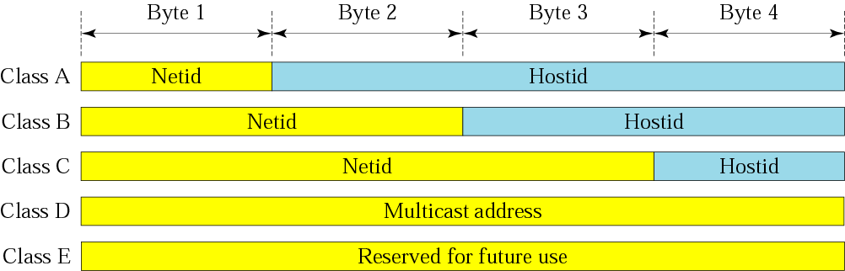
Figure 4-6
Netid and hostid

Slide 72
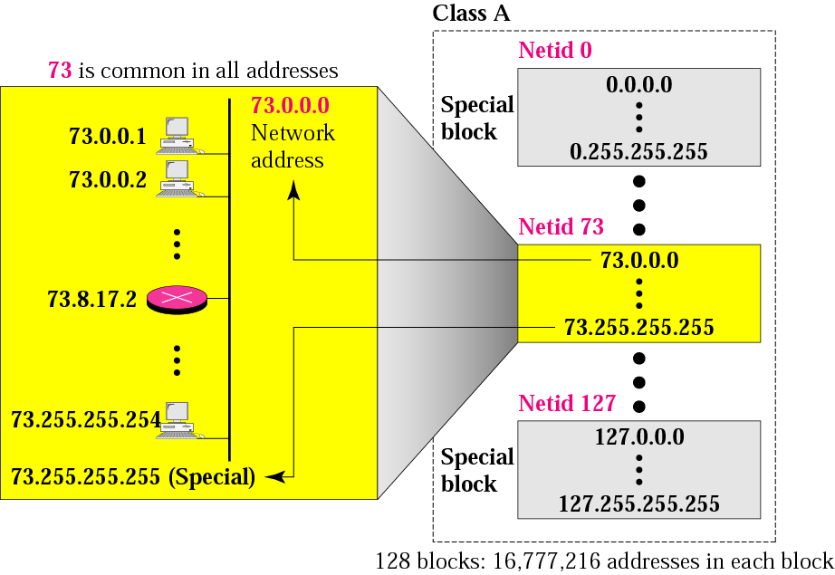
Figure 4-7
Blocks in class A

Slide 73
Millions of class A addresses are wasted.

Slide 74
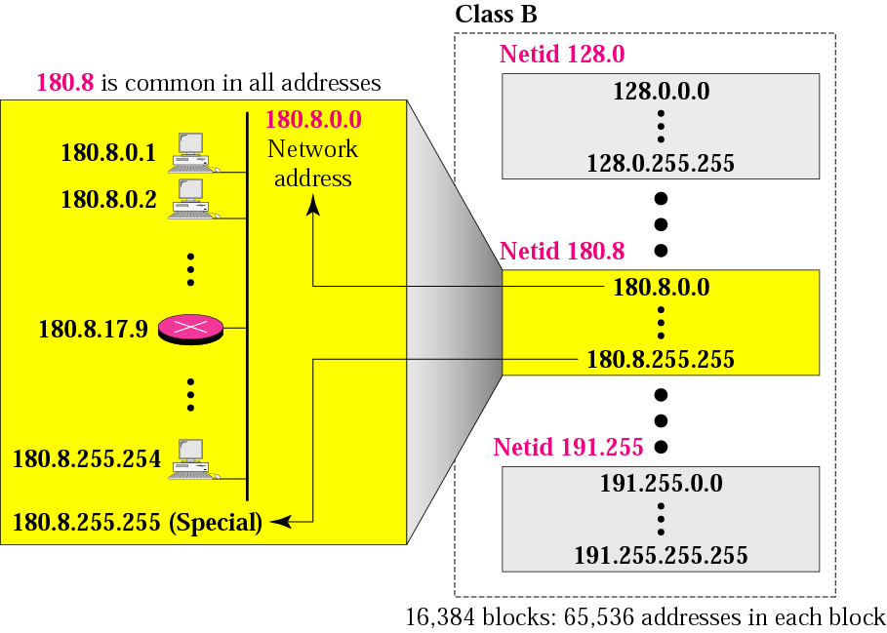
Figure 4-8
Blocks in class B

Slide 75
Many class B addresses are wasted.

Slide 76
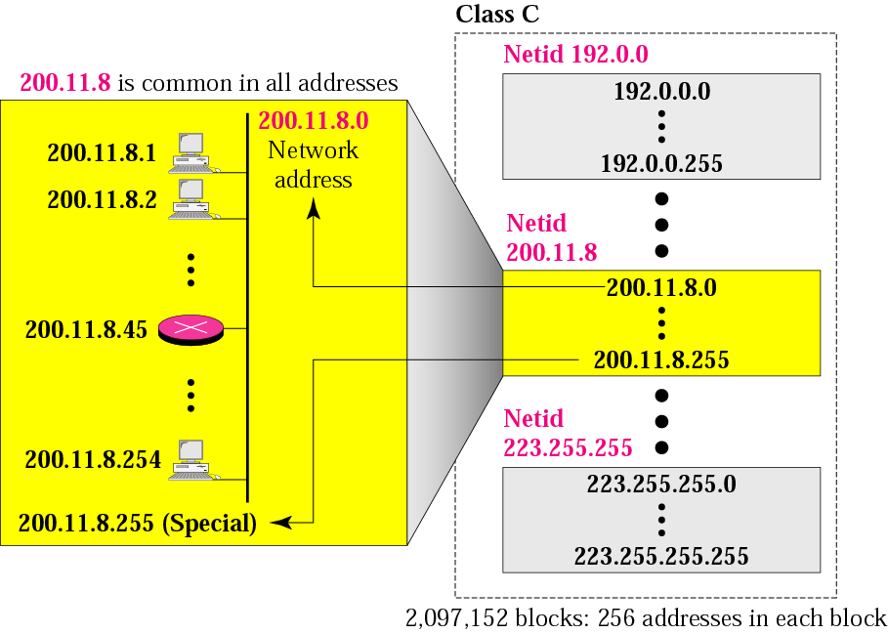
Figure 4-9
Blocks in class C

Slide 77
The number of addresses in a class C block is smaller than the needs of most organizations.

Slide 78
Class D addresses are used for multicasting; there is only one block in this class.

Slide 79
Class E addresses are reserved for special purposes; most of the block is wasted.

Slide 80
Network Addresses
The network address is the first address.
The network address defines the network to the rest of the Internet.
Given the network address, we can find the class of the address, the block, and the range of the addresses in the block

Slide 81
In classful addressing, the network address (the first address in the block) is the one that is assigned to the organization.

Slide 82
Example 9
Given the network address 17.0.0.0, find the class, the block, and the range of the addresses.
Solution
The class is A because the first byte is between
0 and 127. The block has a netid of 17.
The addresses range from 17.0.0.0 to
17.255.255.255.

Slide 83
Example 10
Given the network address 132.21.0.0, find the class, the block, and the range of the addresses.
Solution
The class is B because the first byte is between
128 and 191. The block has a netid of
132.21. The addresses range from
132.21.0.0 to 132.21.255.255.

Slide 84
Example 11
Given the network address 220.34.76.0, find the class, the block, and the range of the addresses.
Solution
The class is C because the first byte is between
192 and 223. The block has a netid of 220.34.76.
The addresses range from 220.34.76.0
to 220.34.76.255.

Slide 85
Mask
A mask is a 32-bit binary number that gives the first address in the block (the network address) when bitwise ANDed with an address in the block.

Slide 86
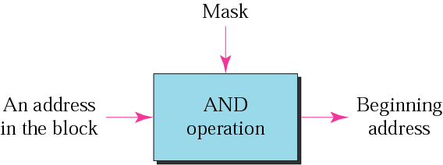
Figure 4-10
Masking concept

Slide 87
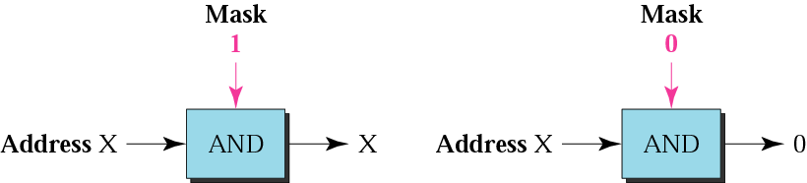
Figure 4-11
AND operation

Slide 88
The network address is the beginning address of each block. It can be found by applying the default mask to any of the addresses in the block (including itself). It retains the netid of the block and sets the hostid to zero.

Slide 89
Default Masks
Class | Mask in Binary | Mask in dotted-decimal
A | 11111111 0…0 | 255.0.0.0
B | 11111111 11111111 0…0 | 255.255.0.0
C | 1…1 00000000 | 255.255.255.0

Slide 90
Example 12
Given the address 23.56.7.91 and the default class A mask, find the beginning address (network address).
Solution
The default mask is 255.0.0.0, which means
that only the first byte is preserved
and the other 3 bytes are set to 0s.
The network address is 23.0.0.0.

Slide 91
Example 13
Given the address 132.6.17.85 and the default class B mask, find the beginning address (network address).
Solution
The default mask is 255.255.0.0, which means
that the first 2 bytes are preserved
and the other 2 bytes are set to 0s.
The network address is 132.6.0.0.

Slide 92
Example 14
Given the address 201.180.56.5 and the class C default mask, find the beginning address (network address).
Solution
The default mask is 255.255.255.0,
which means that the first 3 bytes are
preserved and the last byte is set to 0.
The network address is 201.180.56.0.

Slide 93
We must not apply the default mask of one class to an address belonging to another class.

Slide 94
CIDR (Classless Inter-Domain Routing) Notation
18.46.74.10/8
141.24.74.69/16
200.14.70.22/24
Number of 1’s in the mask
Address Depletion
We have run out of class A and B addresses, and a class C block is too small for most middle-sized organizations.

Slide 95
4.13
OTHER
ISSUES

Slide 96
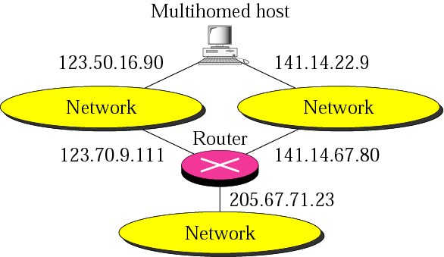
Figure 4-12
Multihomed devices

Slide 97
Location, Not Names
An internet address defines the network location of a device, not its identify.
Movement of computer from one network to another means that its IP address must be changed.
Flat addressing vs. hierarchical addressing

Slide 98
Special Addresses
Special Address | Netid | Hostid | Source or Destination
Network address | Specific | All 0s | None
Direct broadcast address | Specific | All 1s | Destination
Limited broadcast address | All 1s | All 1s | Destination
The host on this network | All 0s | All 0s | Source
Specific host on this network | All 0s | Specific | Destination
Loopback address | 127 | Any | Destination

Slide 99
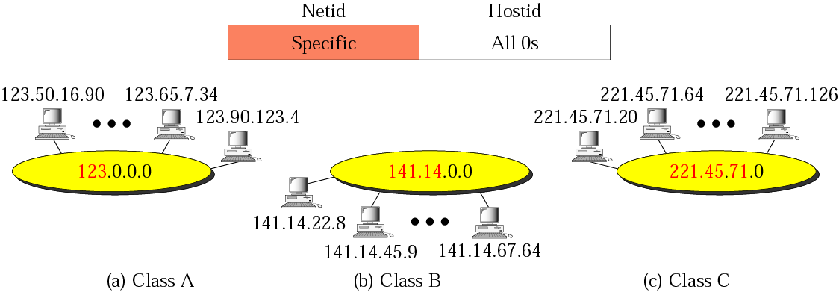
Figure 4-13
Network addresses

Slide 100
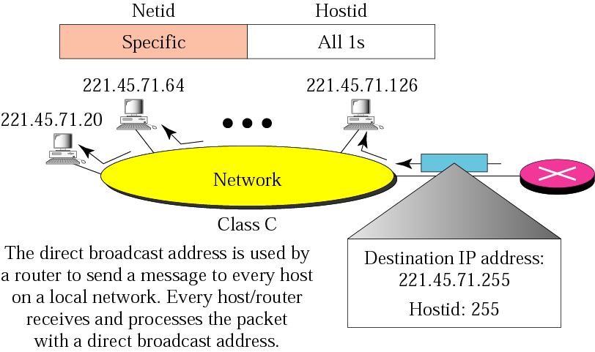
Figure 4-14
Example of direct broadcast address

Slide 101
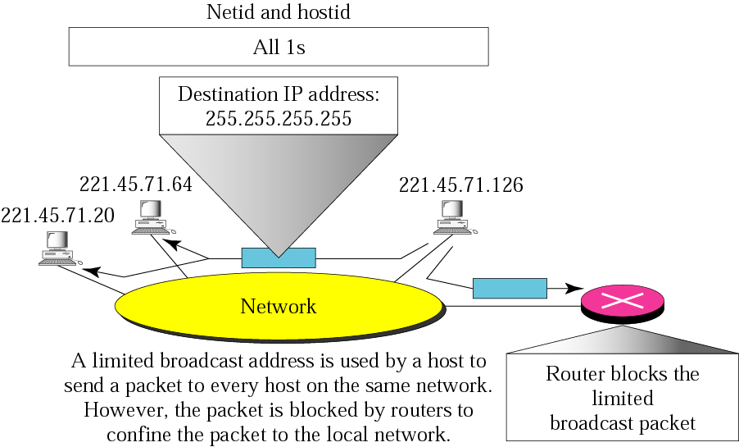
Figure 4-15
Example of limited broadcast address

Slide 102
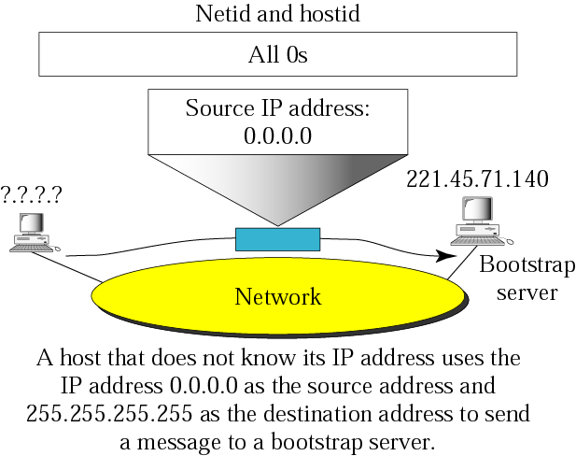
Figure 4-16
Example of this host on this address

Slide 103
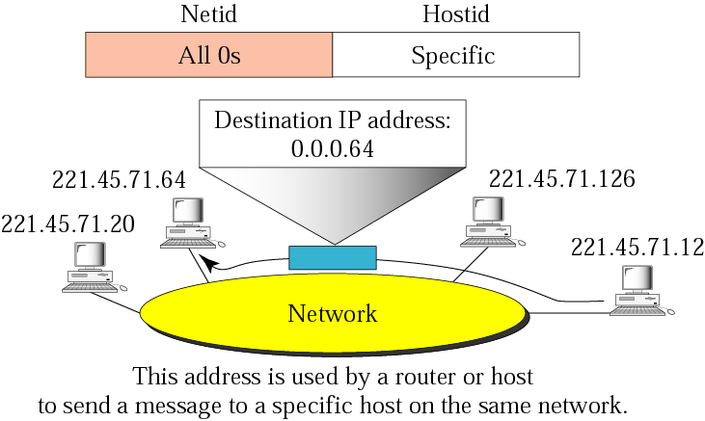
Figure 4-17
Example of specific host on this network

Slide 104
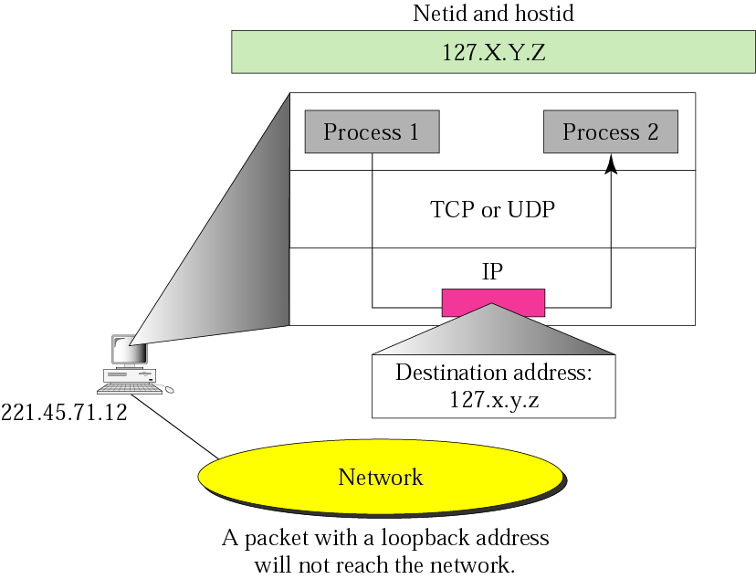
Figure 4-18
Example of loopback address

Slide 105
Private Addresses
A number of blocks in each class are assigned for private use. They are not recognized globally. These blocks are depicted in Table 4.4
Class | Netids | Blocks
A | 10.0.0 | 1
B | 172.16 to 172.31 | 16
C | 192.168.0 to 192.168.255 | 256

Slide 106
Unicast, Multicast, and Broadcast Addresses
Unicast communication is one-to-one.
Multicast communication is one-to-many.
Broadcast communication is one-to-all.

Slide 107
Multicast delivery will be discussed in depth in Chapter 15.

